Slide 1
MULTIMEDIA DATABASE using emmo model
Under guidance of Prof. D.B.Phatak
Mentors:
Mr.Parag Tiwari
Mr.Nagesh Narmali
Mr.Ajay Babar
Team Members:
Bineeta Gupta
Jairaj Solanke
Kirti Gupta
Korada SambaSivaGupta

Slide 2
Multimedia Database
What is Multimedia Database?
Multimedia database is used to contain multimedia collections which supports a mechanism to extract and represent the content of multimedia object.

Slide 3
What is Multimedia?
Combination of one or more primary media files
Multimedia data falls into two categories:
Static Media – time-independent , e.g. text, graphics, images
Dynamic Media – time dependent, e.g. video , speech , animation, etc.
All primary media files are stored in binary strings of zeros and ones and are encoded according to file type.

Slide 4
Issues:-
Open issue of efficient management enabled by sharing and collaborative authoring.
Html,Smil or SVG looses information about semantics of content.
Using RDF and Topic Maps, exchange sharing and collaborative authoring of multimedia content is lost.

Slide 5
Solution:-
EMMO model can be used to realize multimedia content sharing and collaborative applications on the basis of semantically modeled content, along with avoiding the limitations and difficulties of current semantic modeling approaches implied by there isolated treatment of media , semantic description and content functionality.

Slide 6
EMMO
Enhanced Multimedia Meta Objects(EMMO) :-
Three aspects :-
The Media Aspect.
The Semantic Aspect.
The Functional Aspect.
It also supports the “Version” aspect of each Multimedia Objects.

Slide 7
Each EMMO comprises set of four Entities :-
Logical Media Part.
Ontological Objects.
Associations.
EMMO .

Slide 8
APPLICATION OF EMMO
It can be effectively used along with the ProxyMITY tool.
ProxyMITY uses video lecture and its corresponding lecture slides to provide multimedia educational content.

Slide 9
Emmo1
Association1

Slide 10
Emmo2
Association2

Slide 11
Emmo3
(Result shown to User)
Association

Slide 12
Emmo representation of a lecture

Slide 14
Implementation of EMMO Model
Technologies Used:-
JavaEE – EJB, JPA, JSP
MySQL
XML
Glassfish / Tomcat Web Server

Slide 15
DATA FLOW DIAGRAM FOR INSERTING EMMO IN DATABASE

Slide 16
Data flow diagram for Searching lecture in database

Slide 17
Embedded Multimedia Database
Contains multimedia objects in the binary form of zeros and ones in database.
ADVANTAGES-
1. Data is stored centrally which is portable
with its referential integrity intact.
2. Blob can be easily replicated in database.
3. Can be updated directly.
4. No invalid references , Operations on it are
transactional.

Slide 18
DISADVANTAGES-
Size of database will be large.
Retrieval process becomes slow.
Backups are time taking.

Slide 19
Linked Multimedia Database
Can be organized as a database of metadata.
This metadata(URL) links to the actual data such as image, video, audio, presentation etc.
Advantage:- size of database will be small.

Slide 20
SERVER FILE HIERARCHY
MEDIA
avi
dat
01.avi
flv
02.avi
01.flv
01.dat
DBMS.avi
Pointer.flv
Networks.dat
Database.avi

Slide 21
Example :
<XML>
<MediaName> DBMS.avi </MediaName>
<URL> 127.0.0.1 / avi / 01.avi </URL>
</XML>

Slide 22
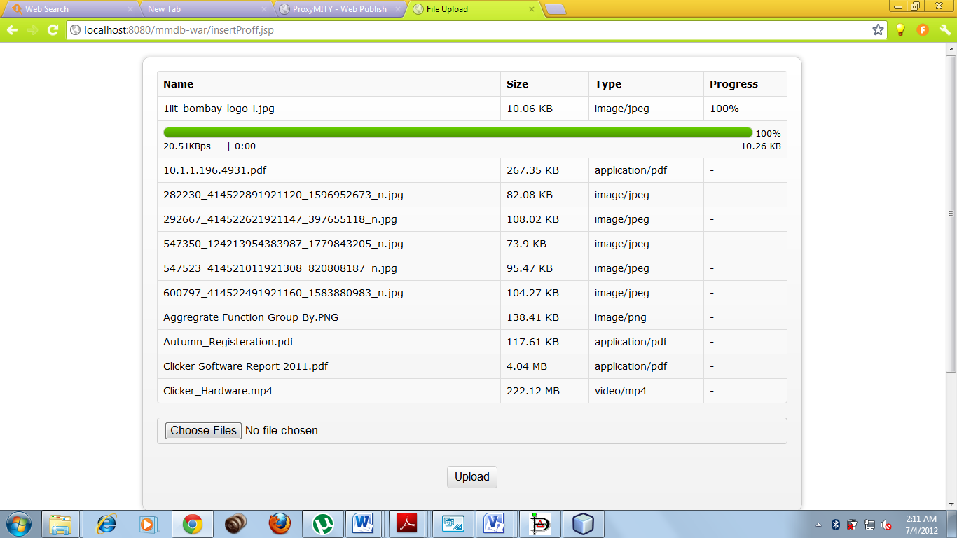

Slide 23
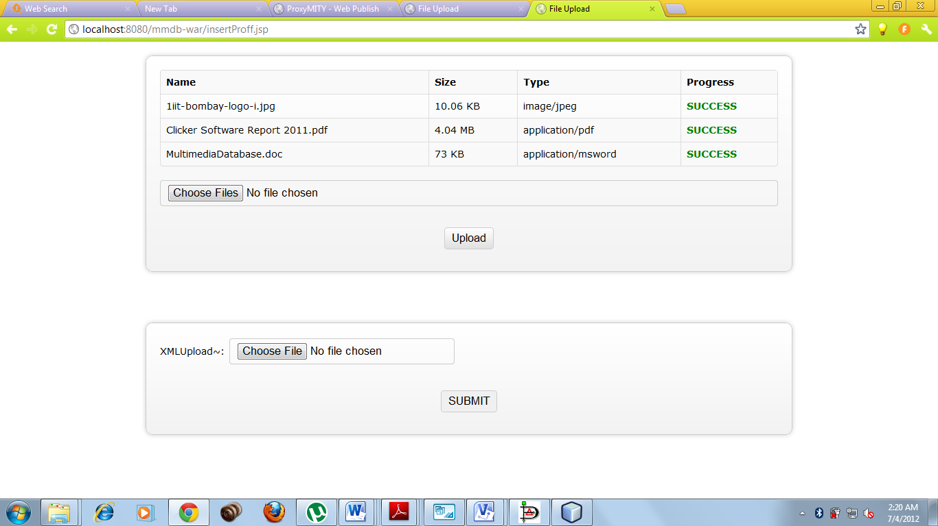
User-Interface for searching a lecture

Slide 25
Future Enhancement
Creation of new emmos:-
Associating two or more emmos to create a new emmo.
The new emmo will be comprised with properties of all the constituting emmos.

Slide 26
EMMO1
EEMMO2
EMMO3
Emmo4
EMMO2
EMMO1
Association

Slide 27
Versioning of emmos :-
Different versions of emmos can be generated.
By adding/ deleting any additional attributes or logical media parts, new versions of emmos can be generated.

Slide 28
` `
EMMO 3
(Oldversion)
EMMO 5
(New version)
EMMO 1
EMMO 3
Associa--tion
EMMO 2
Association
EMMO 4

Slide 29
Caching:-
While displaying result on web, the selected id from json file will be choosen. The id is searched in stored XMLs on server.
If found, the already created XML will be displayed on web.
Otherwise, the id will be sent back to fetch new emmo corresponding to the fetched id.

Slide 30
References:-
phd_sonja_zillner, By-Sonja Zillner
343_Zillner_S , By-Sonja Zillner, Utz Westermann, Werner Winiwarter
Enhancement of Processing Efficiency in mmdb
By-Dr. Dipl.Inf. Harald KOSCH
Database Support for Multimedia Applications - microsoft research By- Michael Ortega, Sharad mehrotra.
Semantic Modeling and Knowledge representation in mmdb By-Wasfi Al-Khatib,

